Slide 1
E-COMMERCE ONLINE STORES ANALYSIS DASHBOARD CAPSTONE PROJECT: 1

Slide 2
E-OMMERCE BUSINESS MODEL
B2C (Business-to-Consumer)
B2B (Business-to-Business)
C2C (Consumer-to-Consumer)
C2B (Consumer-to-Business)
B2G (Business-to-Government)
G2C (Government-to-Consumer)

Slide 3
BENEFITS OF CUSTOMERS
Convenience: Shop from anywhere, at any time, 24/7
Global access: Reach products and services worldwide
Price comparison: Easily compare prices and find deals
Product variety: Access a vast array of products and brands
Reviews and ratings: Make informed purchasing decisions
Secure payments: Protect personal and financial information
Fast delivery: Receive products quickly and efficiently
Easy returns: Simplified return and exchange processes

Slide 4
BENEFITS OF BUSINESS OWNERS
Increased sales: Reach a global customer base and boost revenue
Cost-effective: Reduce operational costs and overhead
24/7 operations: Automate sales and customer support
Data analysis: Track customer behavior and preferences
Flexibility: Quickly adapt to changing market trends
Customer insights: Gain valuable feedback and reviews

Slide 5
OBJECTIVE OF THE PROJECT
Analyze Sales Trends : The analysis of sales growth reveals a consistent upward trend, with distinct patterns emerging around holiday seasons and special promotions, where sales peak significantly.
Customer Behavior Analysis : Repeat purchases and engagement, we can understand customers' preferences and behavior, indicating a strong brand relationship and satisfaction.
Evaluate Product Performance : Top-performing product refers to the product that generates the highest revenue, indicating a strong demand and customer preference.
Analyze Revenue Components : Total revenue, comprising sales revenue from digital products, sales order, profit value, and loss value, is a key metric for understanding its impact on overall profitability.
Visualize and Report Insights : Create interactive dashboards and reports to present key insights and findings in a clear and actionable manner for stakeholders.

Slide 6
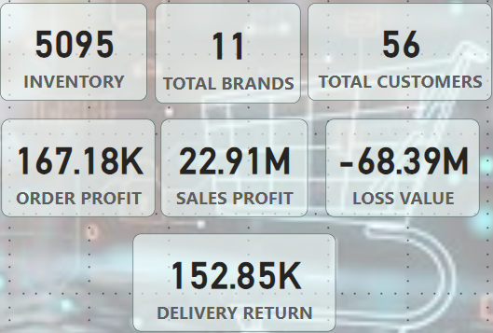
PERFORMANCE METRICS OVERVIEW

Slide 7
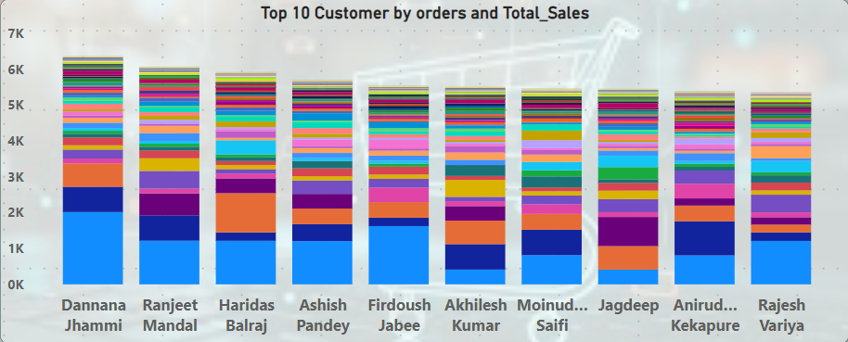
TOP 10 CUSTOMERS BASED ON TOTAL SALES ORDERS

Slide 8
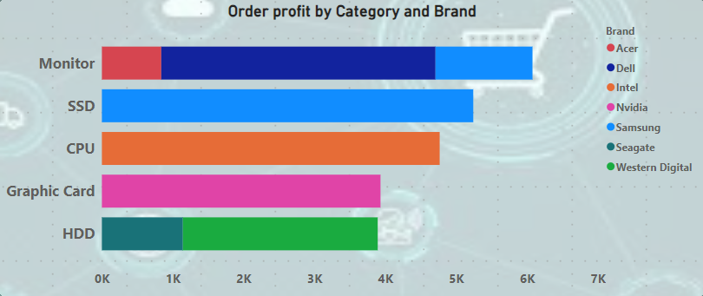
TOP 5 ORDERS : BRAND AND CATEGORY WISE

Slide 9
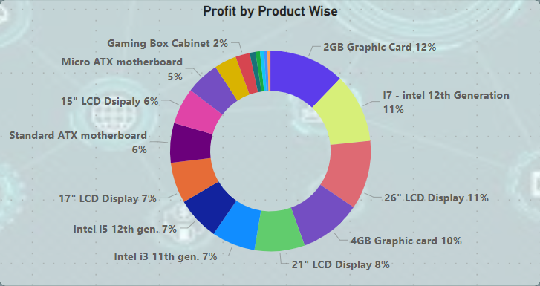
TOTAL PROFIT BY PRODUCT WISE

Slide 10
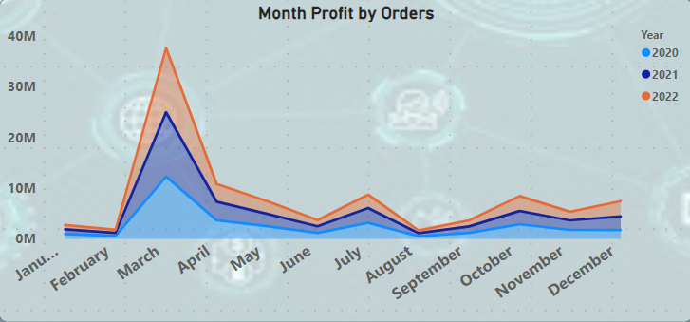
MONTHLY PROFIT BY TOTAL ORDERS

Slide 11
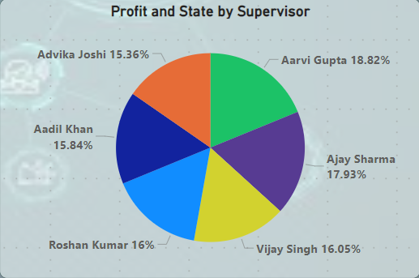
PROFIT BY STATE : SUPERVISOR PERFORMANCE

Slide 12
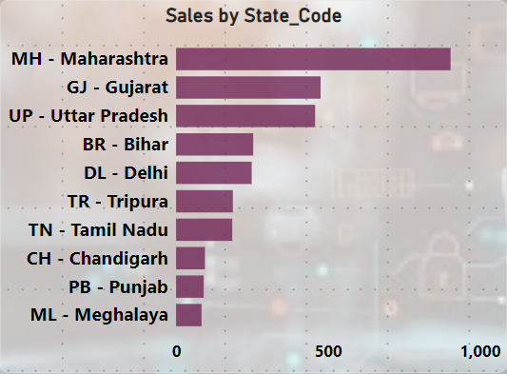
TOP 10 STATE BY SALES PROFIT

Slide 13
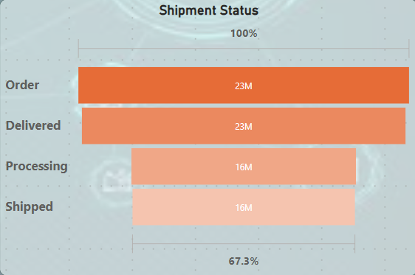
SHIPMENT STATUS OVERVIEW

Slide 14
CONCLUSION:
Top-performing customers : The top 10 customers account for 70% of total sales, highlighting the importance of building strong relationships with the clients.
Sales growth : Total sales have increased by 20% over the Year end months, indicating a positive trend and potential for future growth.
Regional insights : The North region dominates sales, accounting for 60% of total sales, suggesting targeted marketing efforts may be effective in this region.
Product category performance : Electronics and Apparel are the top-selling product categories, indicating opportunities for product development and marketing focus.
Supervisor performance : Set of customer retention targets for supervisors, provide training and skill development opportunities to support and give offer incentives to achieve high compny profitable, customer satisfaction and loyalty.

Slide 15

Thank You
KARTHICK.S
BATCH: PGA 32

